Slide 1

.NET Bootcamp

Slide 2
Overview
Review UI mockups
Fundamentals of software development
The software development lifecycle
Full stack web applications
For next class

Slide 3
Review UI Mockups

Slide 4
Fundamentals of Software Development
How would you build your favorite app?

Slide 5
Fundamentals of Software Development
Gather requirements
Design
Build
Test
Deploy
Maintain

Slide 6
Software Development Lifecycle
How do you manage the development of a software product?
How much do you plan?
What requirements do you need upfront?
When do you start coding?
How do you release the software product?

Slide 7
Software Development Lifecycle
Process

Slide 8
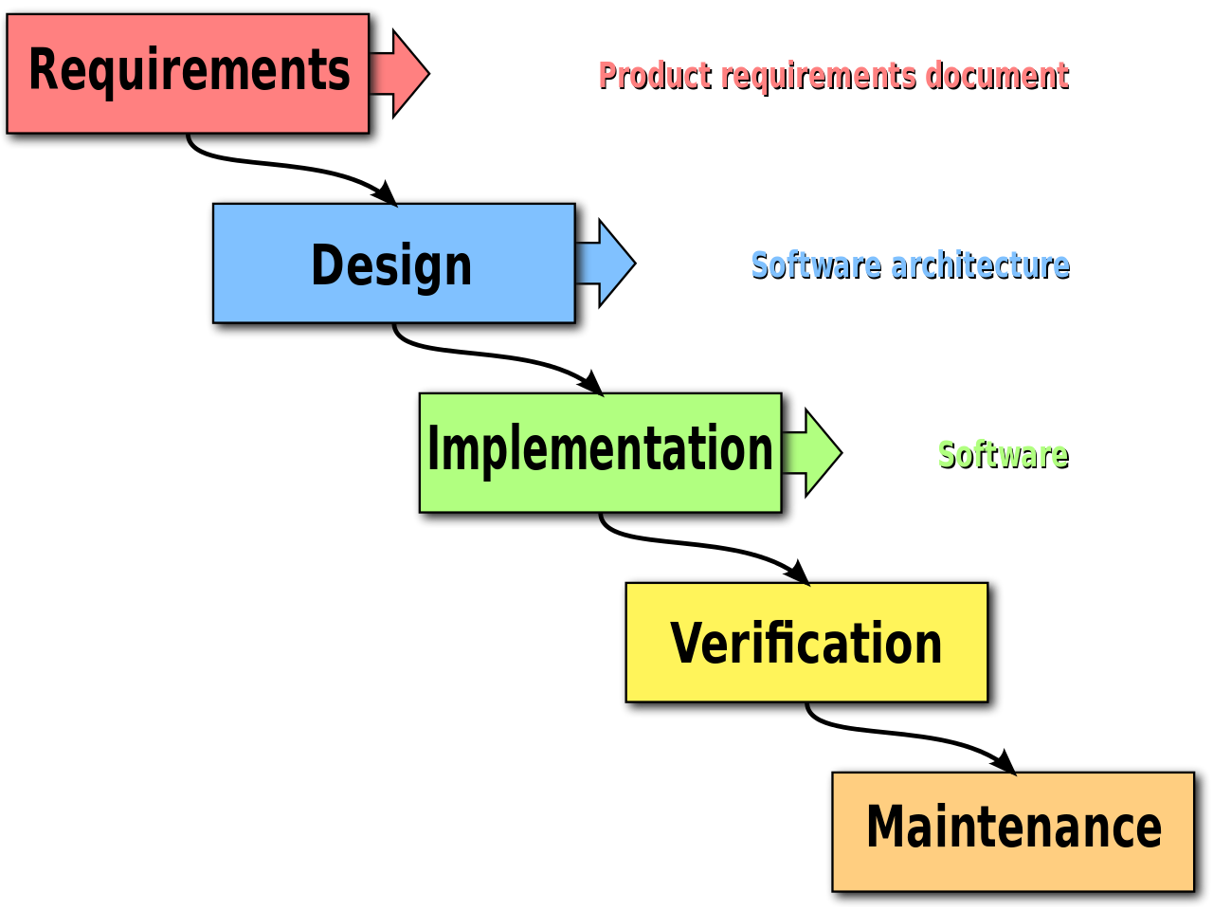
The Waterfall Development Model
https://en.wikipedia.org/wiki/Waterfall_model#/media/File:Waterfall_model.svg

Slide 9
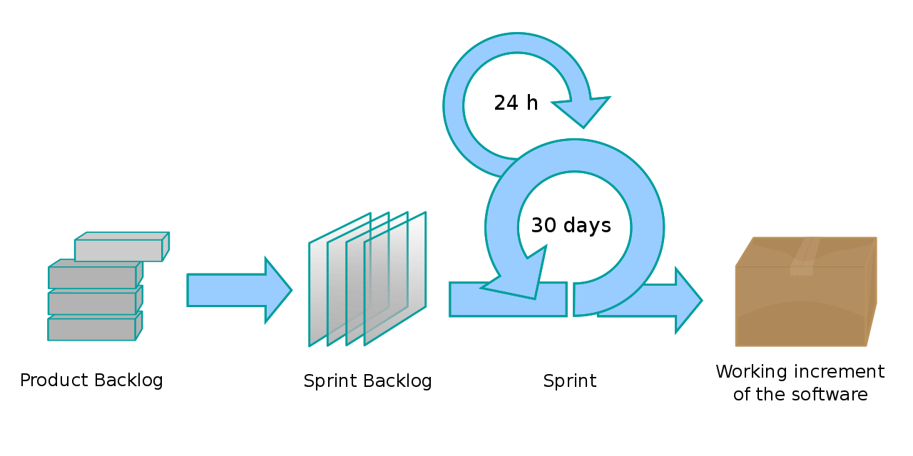
The Agile Development Model
https://en.wikipedia.org/wiki/Scrum_(software_development)#/media/File:Scrum_process.svg

Slide 10
Scrum
An agile framework
Term borrowed from rugby (scrum is a formation of players)
Lightweight, iterative, and incremental process

Slide 11
Scrum
Product owner
Responsible for representing product stakeholders/customer
Development team
3-9 team members (2-pizza rule)
Scrum Master
Acts as a bugger between the team and any distracting influences
Ensures framework is followed

Slide 12
Scrum
Product Backlog
Breakdown of the work to be done usually in a user story/use case and maintained by product owner
Sprints
Usually 2 week timeboxed effort for development kicked off by spring planning
Daily scrum
A daily stand-up meeting timeboxed to 15 minutes to discuss what each developer contributed yesterday, what they’re working on today, and any impediments
Sprint Review
End of sprint to review work completed/not completed, present work to stakeholders, and collaborate with stakeholders on what to work on next

Slide 13
Kanban
Lean method to manage and improve work
No predefined roles
Work is continuously delivered on as-needed basis based on due dates from business
Team members “pull” a new task from backlog once another task is finished

Slide 14
Kanban Board
To Do | In Progress | Testing | Done
Task 1 Task 4 Task 5 Task 7 Task 8 | Task 2 Task 9 | Task 3 Task 10 | Task 6

Slide 15
Software Development Lifecycle
Requirements

Slide 16
Software Development Lifecycle
Before you start coding, you need to gather the requirements:
What is the purpose of the application?
Who will be the users?
What user interactions are your allowing?
Who can perform what actions?
What data do I need to store?

Slide 17
Software Requirements Specification
Lays out functional and non-functional requirements
Very detailed document (use cases, UML, sequence diagrams, ERD, etc)

Slide 18
User Stories
A User Story is a structure for documenting how the user does their work
Each user story is written from the perspective of the end user
Example: As a <role> I want <capability>, so that <receive benefit>
Often will need to break user stories up into smaller tasks for Kanban

Slide 19
Ecommerce Example of User Interaction
Seller
can request account
can post products
gets paid for purchases
Buyer
can sign up for an account
can browse all products
can purchase products
Admin
can remove sellers or buyers

Slide 20
Software Development Lifecycle
Design

Slide 21
Architectural Designs
Client-server
Server provides services to one or more clients
Clients request services from the server
3-tier/n-tier/layered architecture
A client-server architecture in which the presentation, the business logic, and data management are logically separate processes

Slide 22
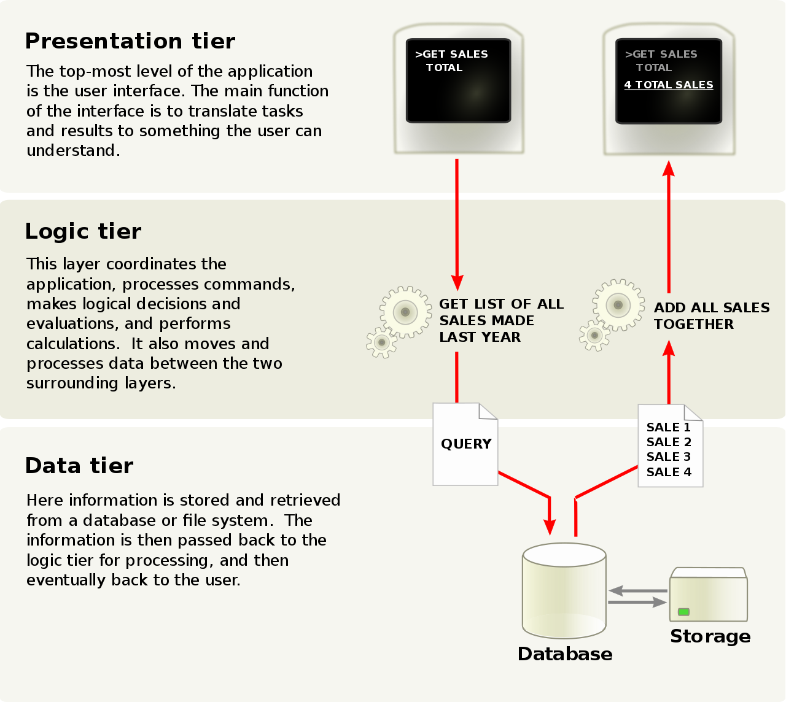
3-Tier Architecture
https://en.wikipedia.org/wiki/Multitier_architecture#/media/File:Overview_of_a_three-tier_application_vectorVersion.svg

Slide 23
Data Modeling
What data do you care about?
At the minimum, what data should we save of the data our users entered
Is there more data?
We’ll dive deeper into data modeling and databases in later classes

Slide 24
Software Development Lifecycle
Testing
We’ll discuss this later during our testing/code review class

Slide 25
Software Development Lifecycle
Deploying
We’ll discuss this later during our Azure/cloud class

Slide 26
Software Development Lifecycle
Maintenance

Slide 27
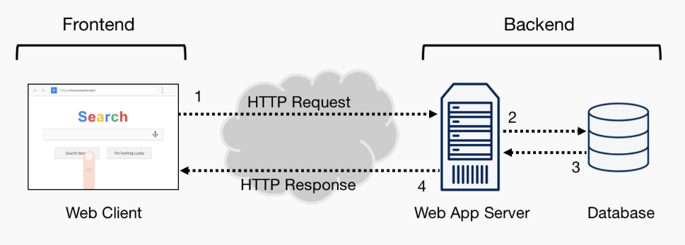
Fullstack Web Applications

Slide 28
Frontend
Controls what the user sees and interacts with
Calls the backend to send and receive data
Frontend technologies:
HTML, CSS, JavaScript (*WASM)
Libraries and Frameworks: React, Angular, Vue, jQuery, Bootstrap, etc.

Slide 29
Backend
Responsible for sending data to the client
Receives data from client
Processes data for client
Connecting clients
Backend Technologies:
Most programming languages: C#, JavaScript, Java, Ruby, Python, etc.
Frameworks: ASP.NET, Express.js, Ruby on Rails, Django, Spring, etc.

Slide 30
Performance Concerns
Frontend
Code runs on the client hardware (web browser, mobile, desktop, etc)
Code runs separately for each user
Must be responsive to the user events and render the screen quickly
Backend
Code runs on the server
Code handles multiple requests and users from one instance
Must be responsive to many users simultaneously, processing and transmitting data quickly

Slide 31
For Next Class
Create a GitHub organization for your project
Break down your application into manageable tasks and create issues in GitHub

